Slide 1

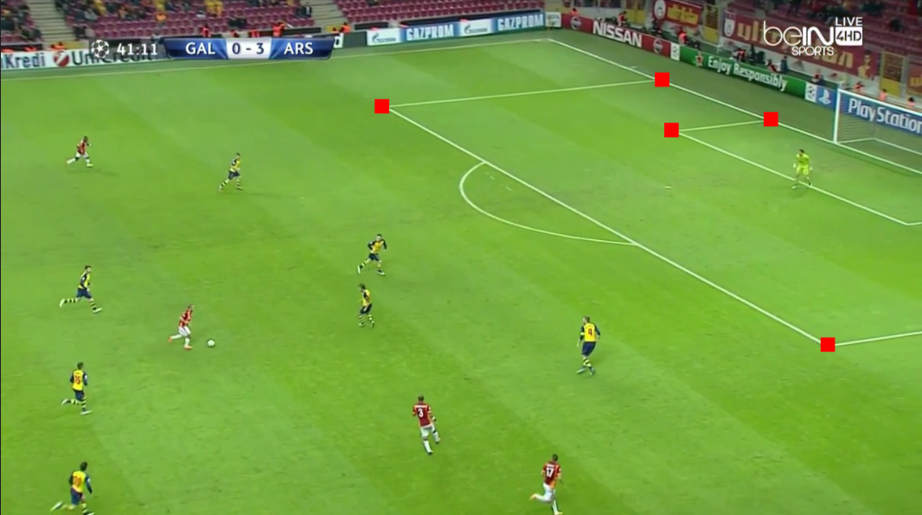
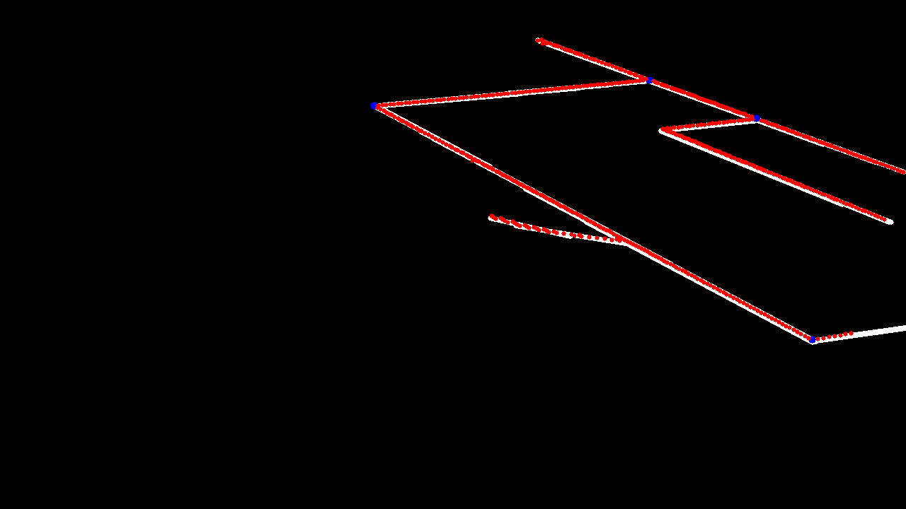
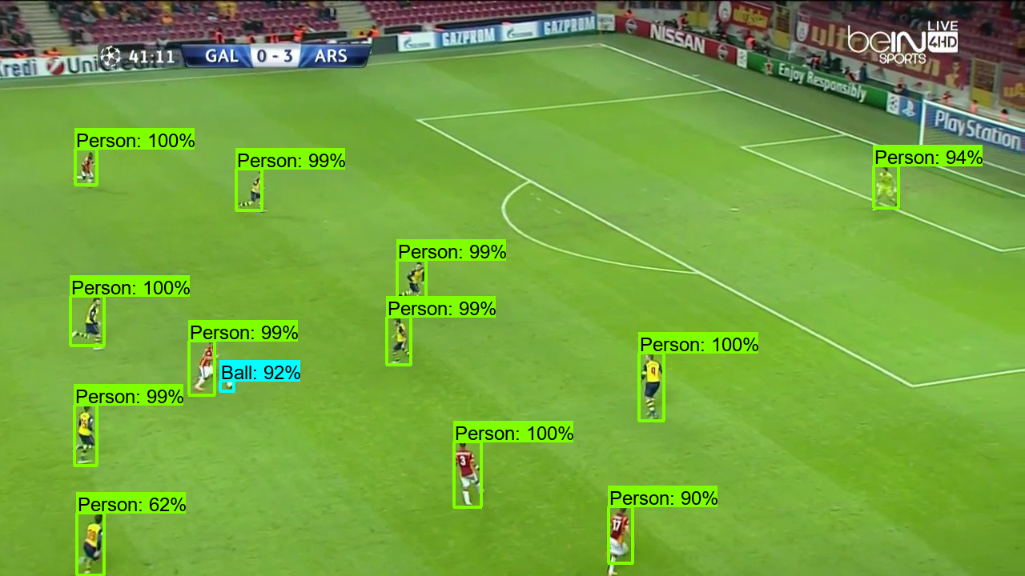
Computer Vision Approach to Football Player Mapping
Bryant Cornwell, Seth Mize, Lucas Franz, Luddy School of Informatics, Computing, and Engineering, Indiana University
Abstract
Methods
Results
Professional sports industries continue to increase their reliance upon analytics, one of the primary being the tracking of player movement. In football (soccer) this is even more prioritized as the game relies upon player positioning and movement on a vast playing surface. Modern techniques utilize wearable technology to accomplish this. This project argues that through the adaptation of existing computer vision techniques the same results can be achieved and democratized. Utilizing image channel thresholding, Hough Transformations, algebra, linear algebra, and a deep neural network, our results illustrate the possibilities of transforming player and ball locations from broadcast images into a 2-dimensional overhead coordinate space.
Source Feature Point Detection
Filter Hue channel
Apply grayscale thresholding
Apply Hough Transformation
Solve for the valid intersections
Solve Projection Matrix
Select 4 feature points
Test destination combinations
Vote based on inverse projection
Object Detection
Self-Labeled Image Dataset
TensorFlow 2 Object Detection API
Pre-Trained Model: Faster R-CNN with the COCO Dataset
Apply Projection
Ingest projection matrix and objects
Apply projection to object
Plot objects in destination
Background
A variety of computer vision techniques have been applied to applications ranging from tangential to highly relatable
Line detection is a highly relatable application with lane detection for autonomous vehicles being a leading candidate
Projection is a standard concept in the computer vision toolkit being applied for simple translations or as a piece of a broader application
Object Detection has a myriad of fully researched applications, with applications in the sports industry being one of them.
Conclusion
Object recognition for event tracking and statistical analysis.

